Slide 1
PROJECT MANAGEMenT

Slide 2
DEFINITION OF A PROJECT
A project is a temporary endeavour under taken to create a unique outcome, product or service.
Temporary means that every project has a definite beginning and end.
Unique means that the outcome is different in in some distinguishing way from similar outcomes, products or services
OR
A project is a unique set of activities that are meant to produce a defined outcome, with a specific start and finish date, and a specific allocation of resources

Slide 3
DEFINITIION OF PROJECT MANAGEMENT
Project Management is the planning, organising, directing and controlling of organisational resources for a relatively short-term objective, that has been established to complete specific goals and objectives.

Slide 4
6 PHASES OF A PROJECT
ENTHUSIASM
DILLUSIONMENT
PANIC
SEARCH FOR THE GUILTY
PUNISH THE INNOCENT
PRAISE AND HONOURS FOR THE NON-PARTICIPANTS

Slide 5
THE ROLE OF PROJECTS IN ORGANISATIONS
STRATEGY
PROJECTS
Change
OPERATIONS
Business as Usual
Integrate
Today’s Project is tomorrow’s “business as usual”

Slide 6
CRITICAL ELEMENTS TO PROJECTS
OUTCOMES: Technical Specification and Quality Requirements
TIME: Due Date and Schedule
COST: Budget and Financial Outcomes

Slide 7
THE ROLE OF PROJECTS IN ORGANISATIONS
STRATEGY
PROJECTS
Change
OPERATIONS
Business as Usual
Integrate
Projects, Programs and Strategies
Project Plans
Time line
One off Objectives
Processes
Budgets
Operational Plans
Top Down Objectives

Slide 8
THE PROJECT MANAGEMENT PROCESS
CONCEPT
DEVELOPMENT
IMPLEMENTATION
FINALISATION
Project Identification & Initiation
Detailed Preparation, Design & Planning
Detailed plan and scoping
Finalisation, Completion & Handover
Preliminary Scoping & Assessment
Higher Level Plan
Work issue and execution
Client Acceptance
Low Level approval
Monitoring, Feedback and Control
Post Audit

Slide 9
PROJECT MANAGEMENT PROCESSES
INITIATING
PLANNING
CONTROLLING
EXECUTIING
CLOSING

Slide 10
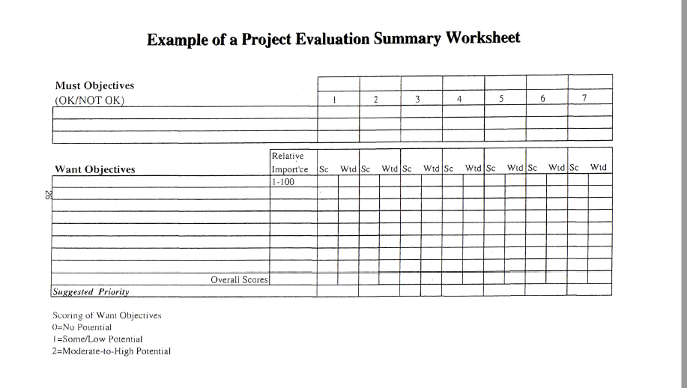
PROJECT SELECTION & PRIORITISATION

Slide 11
PROJECT SCOPING & DECISION FACTOR
Background to the Project
Customer Requirements and prorities
Strategy & Plans
Opportunity or Problem Definition
Current Situation Anaylsis
Potential Alternatives
Expected Benefits
Risk Considerations
Preliminary Plan & Schedule

Slide 12
PROJECT ASSESSMENT & SELECTION
Is the Project Doable?
Technical and Economic Feasibility
Does it Make Sense to do it?
Strategic fit with organisation’s mission, objectives and strategy
Do we have anything better to do?
Basis of comparison between, potential projects. Which are more important

Slide 13
DEVELOPING THE SCOPE OF WORK
TO DO LIST
FULL WORK BREAKDOWN STRUCTURE

Slide 14
WHAT IS A WORK BREAKDOWN STRUCTURE? (WBS)
The WBS provides a basis for dividing a project level scope into manageable, definable packages of work;
The WBS is a way of translating packages of work together for project objectives. These are then prioritised and formed together into parent/child heirachies

Slide 15
WORK BREAKDOWN STRUCTURES
Breaks down the project objectives into increasingly detailed sub-objectives, activities and tasks.
PROJECT
TASK
TASK
SUB-TASK
SUB-TASK
WORK PACKAGE
WORK PACKAGE

Slide 16
OUTCOMES OF THE WBS
Increases chance that all work will get completed
Assists in the planning process
Helps with budgeting, scheduling, resource availability and control
Shows key activities and steps for completion
Helps identify complexities
Defines clear responsibility for tasks
Shows where risk of time, complexity and resource allocation
Assists Project Manager to monitor resource use and reporting

Slide 17
DEVELOPING A WBS
Clearly define objectives
Create steps to get to the objectives
What are the major outcomes required
How much time is required
Who will do it
When is it due

Slide 18
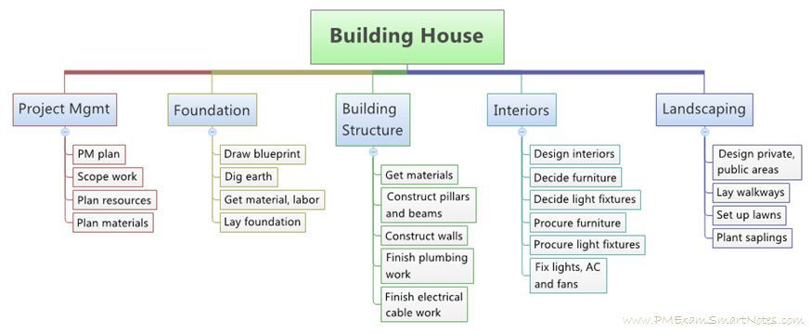
SAMPLE WBS – BUILDING A HOUSE

Slide 19
MANAGING SCOPE
Have a clearly defined and documented scope that is agreed up front in a Project Summary Report
Have a clearly defined procedure for changes to scope
Have clearly defined procedure for dealing with emergent work, additional work and underestimation of existing work
Double check WBS and make sure that nothing has been forgotten?
Report monthly on progress
Have a “wish list” documented for out of scope work

Slide 20
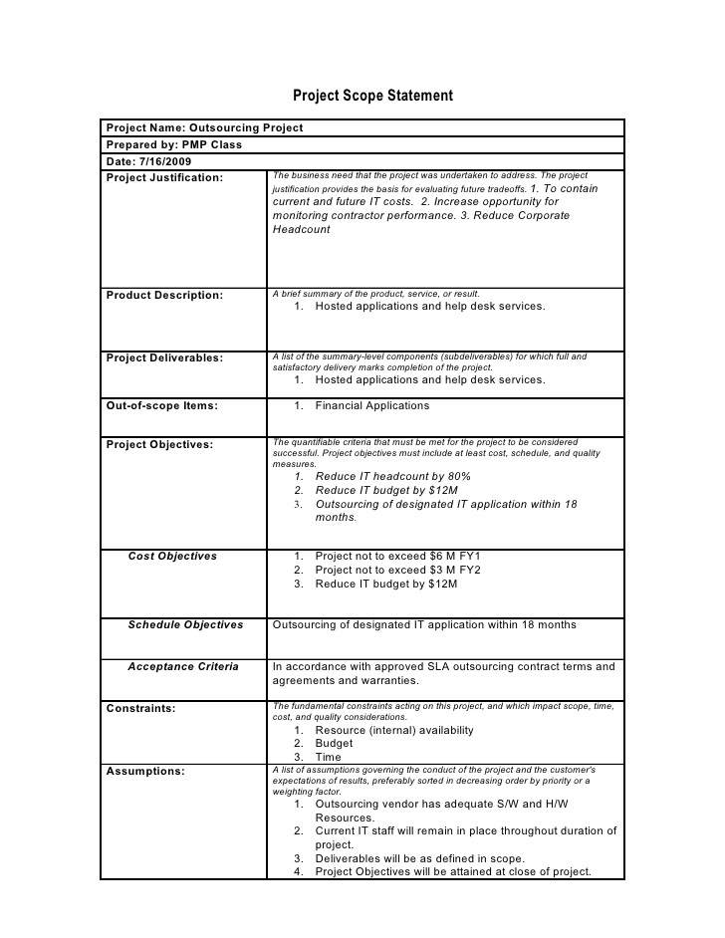
PROJECT SUMMARY REPORT

Slide 21
CRITICAL PATH METHOD
Is a management tool that allows us to:
  Plan
    Establish a Logical progression of work
    Establish timings
    Determine resource requirements
    Develop a budget
  Control
    Control Progress
    Control Costs

Slide 22
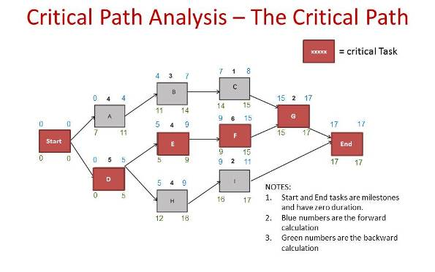
What the Critical Path looks like…

Slide 23
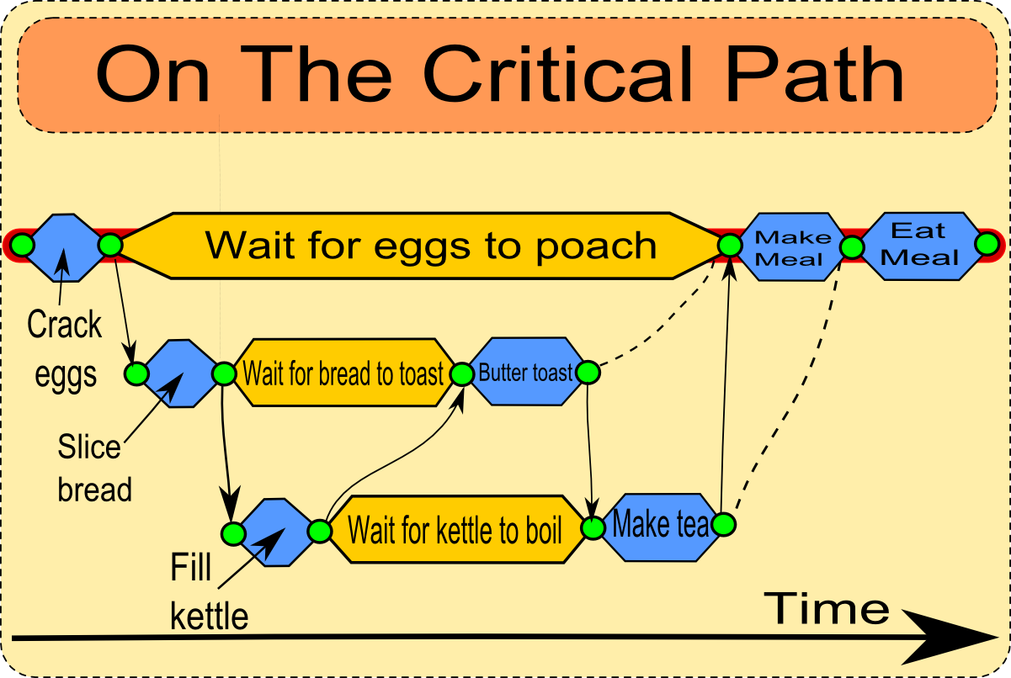
Critical Path in real life…

Slide 24
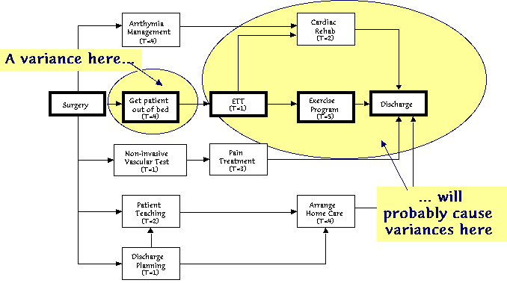
Critical Path in the real world…

Slide 25
Reporting Control
Monthly Control (Overall Project Manager)
Weekly Control
(Task/Team Manager)
Daily Control
(Workers)

Slide 26
PROJECT MILESTONES
Milestones – points in the project representing the completion of key activities.
  Strictly defined, milestones are tasks, inserted in the project network have a zero duration, consume no resources and are control points only
  Milestones may be created just to have a control point for checking the project OR they may naturally occur in the form of key tasks in the network

Slide 27
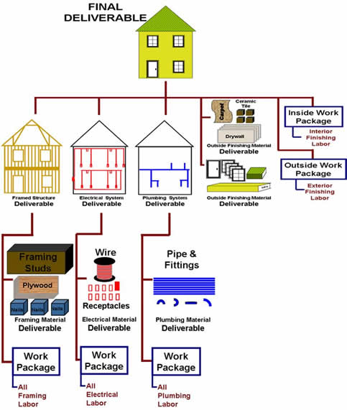
Project Control: Milestones & Selection

Slide 28
MANAGING SMALL PROJECTS
Normally have a small team, who also have to work on other tasks in normal business operations
Use a formal project management technique for easy of reporting and management of project
Often a significant financial commitment relative to the size of the organisation undertaking the project
Less detailed planning required – can take shortcuts
Manual systems are normally fine to use, i.e. excel spreadsheets
Less formal reporting, for instance can manually mark up diagram or paper copy

Slide 29
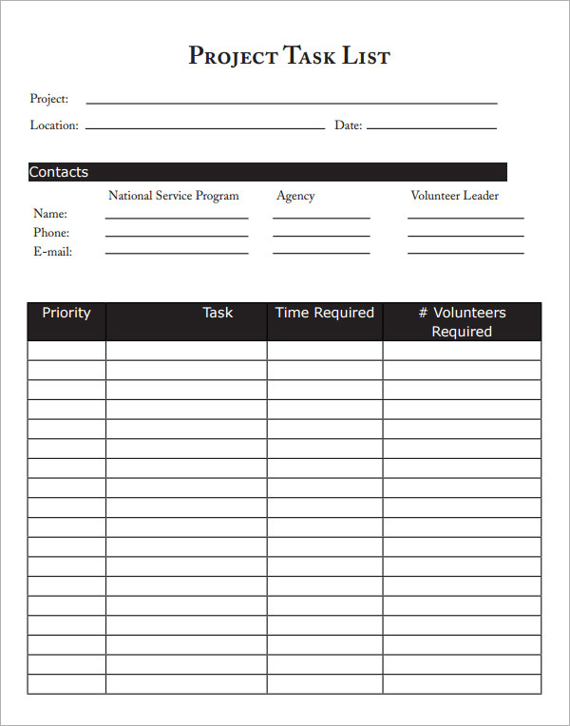
Small Project Planning
List tasks, Resources & Duration

Slide 30
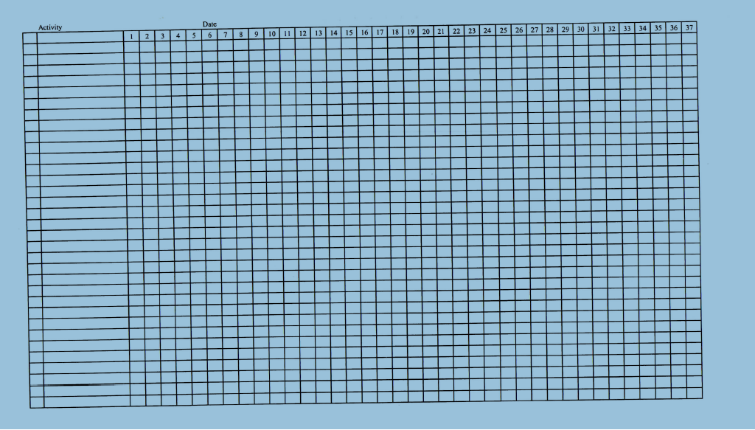
Create WBS & GANTT Chart

Slide 31
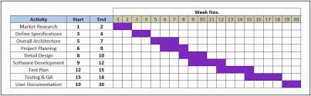
WBS & GANTT CHART

Slide 32
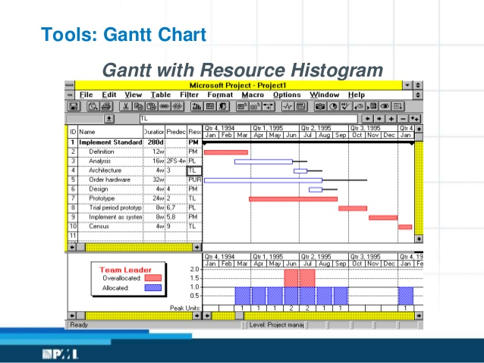
RESOURCE HISTOGRAM

Slide 33
TIPS AND TRICKS
Use every second row for the WBS, then you can track the progress in the link below in a different colour
Changes to plan can be done by inserting new rows and columns
Always keep an original copy of the first plan separate to other plans and working files

Slide 34
PROJECT MANAGEMENT
Project Managers are concerned about:
  Time
  Tasks
  People
  Results
  Need a balance across all 4 to be a good Project Manager

Slide 35
PROJECT LEADERSHIP
When the best leader’s work is done, the people say
“We did it ourselves”
Lao-Tzu

Slide 36
Cause & Effect……….
CORE SKILLS – Self Awareness, Goal Setting & Planning, Communication
SUPPORT SKILLS - Delegation feedback & Control, Time management & Self Management, Problem Solving, Decision Making
EFFECTS – Conflict Management, Team Building, Motivating & Influencing, Stress Management

Slide 37
Effort – Throwing Resources at a Project slows it down…..
For projects depend on intellectual effort, more resources when project gest into trouble can make things worse.
This is because people already on the project have to stop or slow down in order to make time to get new members up to speed before becoming productive
The time lost doing this can be more than the gains achieved by the extra resources

Slide 38
EFFECTIVE PROJECT MANAGEMENT
Effective Project managers do not need to be technical specialists
Specialisation can often slow things down as managers get stuck into the detail
Effective project management unleashes the team to do the content of the project
THE ROLE OF THE PROJECT MANAGER IS TO:
  Interface with Management
  Planning Agent
  Team Leadership

Slide 39
INTERFACE MANAGEMENT
Managing People within the project team
Maintaining the balance between technical and managerial project functions
Coping with risk – ensuring the risk assessment done to an adequate level and acceptable trade-offs are made;
Surviving organisations contraints i.e. dealing with organisational politics

Slide 40
PLANNING AGENT
Ensuring the scope of work is clearly defined and complete task definitions developed
Resource requirements defined
Major timetable milestones identified and agreed
Success criteria for project completion – technical/quality criteria defined
The basis for performance measurement defined and project reporting system in place

Slide 41
TEAM LEADERSHIP
Guiding the team through the team formation process
Establishing ground rules for team working
Establishing and reinforcing a strong performance ethic within the team;
Acknowledge the value of individual contributions
Balancing the concerns for tasks, people, time and results

Slide 42
LAUNCHING AN EFFECTIVE TEAM
Establish ground rules
Develop a team mission/purpose
Develop a shared team vision
Develop specific team goals, objectives and performance targets

Slide 43
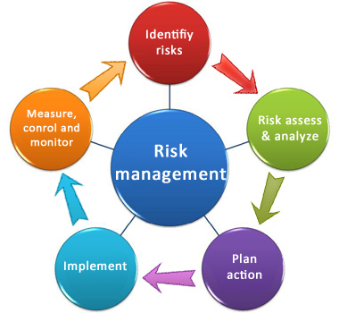
RISK MANAGEMENT

Slide 44
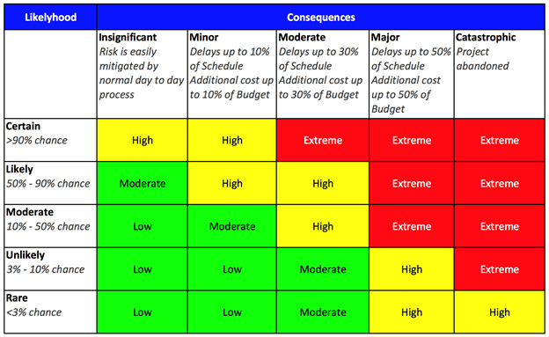
RISK MANAGEMENT

Slide 45
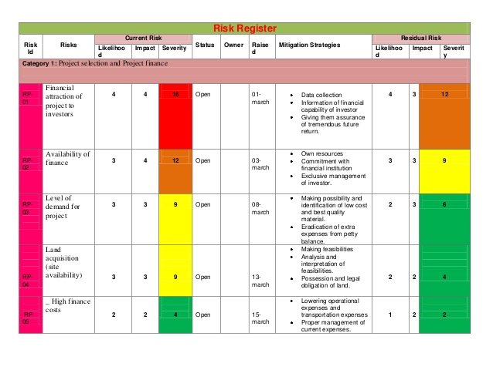
RISK REGISTER

